Slide 1

Pens and Printers
Product Sales Analysis
Emre Can

Slide 2

Agenda
Problem Statement
The Dataset
Findings
Summary

Slide 3
Problem Statements
What is the most effective sales approach?
(Email, Call, Email & Call)
How many customers are there for each approach?
What does revenue spread look like, and for each method?
How does revenue change over time?

Slide 4
The Dataset
15000 unique records, 8 fields.
Missing / faulty data in 1078 records.
Some data entry corrections on sales method field.

Slide 5
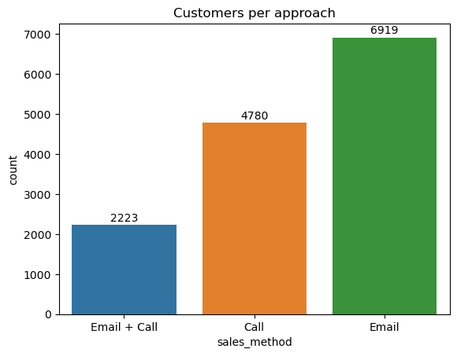
Findings
Customers for Each Approach

Slide 6
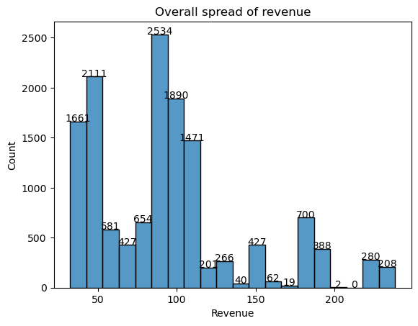
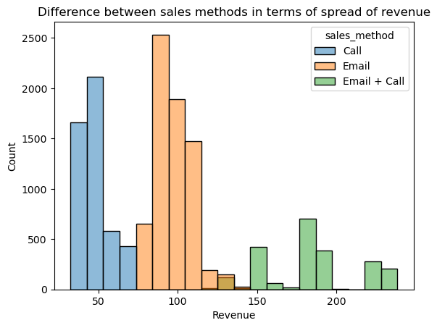
Findings
Overall Revenue Spread & Revenue Spread per Sales Approach

Slide 7
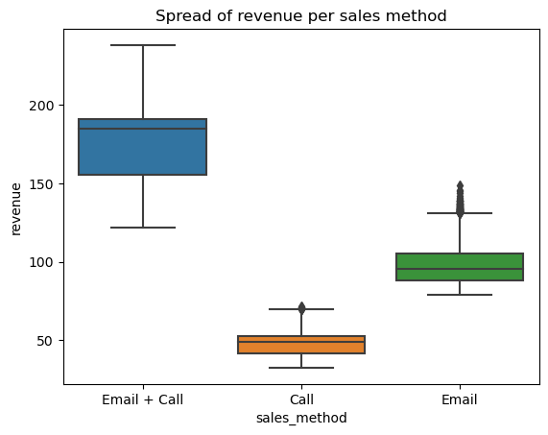
Findings
Revenue Spread per Sales Approach

Slide 8
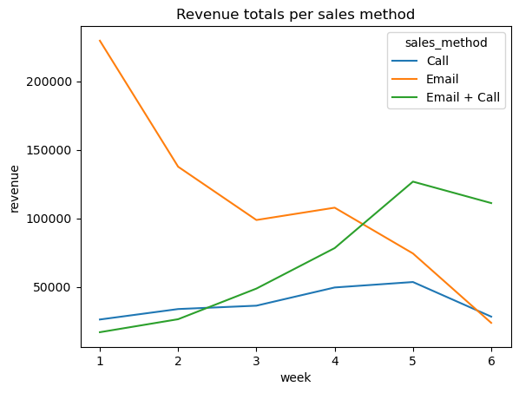
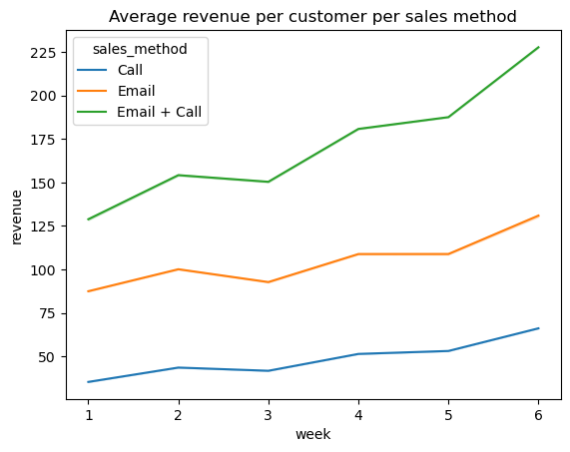
Findings
Revenue Totals vs. Revenue Means

Slide 9
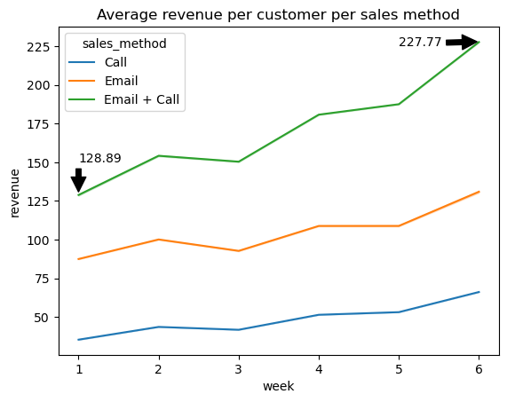
Findings
Business Metric to Track

Slide 10
Summary
Most efficient sales approach is Emails + Calls
Business metric to track is the average revenue per customer.
Average per customer revenue is 227.77 by Week 6
Pens And Printers should cast a wide net with Emails, then follow up with interested customers via phone call.

Slide 11
Thank you!

